Slide 1
Optical Fiber Cable Design
Optical fiber cables are designed to protect fragile (vongur) fibers, maintain signal quality, and ensure mechanical strength.

Slide 2
Fiber Buffering
Buffering is the first layer of protection applied to the fiber to prevent microbending and physical damage.
Tight Buffering: A thick layer of plastic (like PVC) is applied directly onto the fiber coating.
It is used for indoor cables where flexibility and durability are needed.
Example: A patch cord used to connect a computer to a wall outlet.
Loose-Tube Buffering: The fiber sits loosely inside a larger, hard plastic tube which is often filled with a water-resistant gel.
This allows the fiber to move slightly when the cable expands or contracts due to temperature.
Example: Outdoor trunk lines buried underground.
PVC-এর পূর্ণরূপ হলো Polyvinyl Chloride। অপটিক্যাল ফাইবার নেটওয়ার্কিং এবং ক্যাবল ডিজাইনের ক্ষেত্রে এটি একটি অত্যন্ত গুরুত্বপূর্ণ পলিমার বা প্লাস্টিক উপাদান, যা মূলত ফাইবারের সুরক্ষা নিশ্চিত করতে ব্যবহৃত হয়।

Slide 3
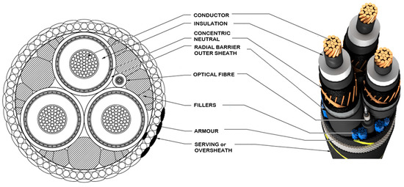
Cable Strength and Structural Members
To prevent the fiber from being stretched or crushed during installation, strength members are added to the cable.
Central Strength Member: A rod made of steel or fiberglass (FRP) placed in the center of the cable to provide rigidity.
Aramid Yarns (Kevlar): Strong synthetic fibers wrapped around the buffer tubes to provide high tensile strength, allowing the cable to be pulled through conduits without breaking.
Example: Long-haul undersea cables use multiple layers of steel wire armor to withstand extreme ocean pressure.

Slide 4
DFB Laser vs. Fabry–Pérot Laser
The primary difference lies in how they achieve single-frequency (single-wavelength) operation.
Fabry–Pérot (FP) Laser: This laser uses two mirrors at the ends of the semiconductor material.
Light bounces back and forth between them, but this often results in multiple "modes" or wavelengths being emitted.
This causes more dispersion (spreading) over long distances.
Distributed Feedback (DFB) Laser: Instead of simple mirrors, a DFB laser has a Bragg Grating etched directly into the semiconductor.
This grating acts like a highly specific filter that only allows one precise wavelength to be amplified.
Comparison: If an FP laser is like a flashlight emitting a broad beam, a DFB laser is like a high-precision pointer emitting a single, pure color.
This makes DFB lasers essential for high-speed WDM systems.

Slide 5
Fabrication of Fiber Couplers
Fiber couplers are passive components used to split or combine light signals.
1. Fused Biconical Taper (FBT) Method
Process: Two or more fibers are stripped of their coatings, placed side-by-side, and twisted together.
They are then heated (usually with a flame) until they soften and are pulled or "tapered" until they fuse together.
Mechanism: As the fiber cores get thinner, light "leaks" from one fiber into the other.
Example: A 3 dB Coupler created this way will take 10 mW of input power and split it into two 5 mW outputs.
2. Polished Fiber Method
Process: Two fibers are partially embedded in separate glass blocks.
The cladding of each fiber is polished away until it is very close to the core.
The two polished surfaces are then pressed together with an index-matching oil between them.
Mechanism: Light moves between the fibers through "evanescent wave coupling."
Example: This method is often used to create Wavelength Selective Couplers that can
separate two different colors of light, such as 1310 nm and 1550 nm signals.

